Slide 1
Introduction to NLP in Python!
By: Iman Khani Jazani
AI and Data Specialist, Business Developer | AiHum
Adjunct Professor | Sharif University of Technology
Senior Data Scientist, Community builder | Adin

Slide 2
Last Lecture
Short Presentations
Review the last lecture
Data story telling
Visualization in Python!
Application of Programming in the Digital Age!

Slide 3
Today
Short Presentations
Introduction to NLP
Introduction to regular expression
Introduction to NLTK and Hazm
Some applicational package in python
Application of Programming in the Digital Age!

Slide 4
Together
Send your feedback about the class whenever you want!

Slide 5
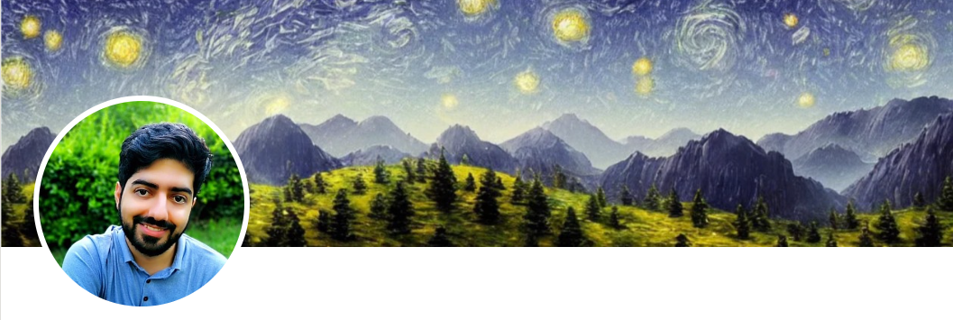
Contact me
Gmail: ImanKhaniJazani@gmail.com
LinkedIn: https://www.linkedin.com/in/ImanKhaniJazani/
Telegram: @IKJ1992

Slide 6
Short Presentations

Slide 7
Review the Last Lecture

Slide 8
Introduction to NLP

Slide 9
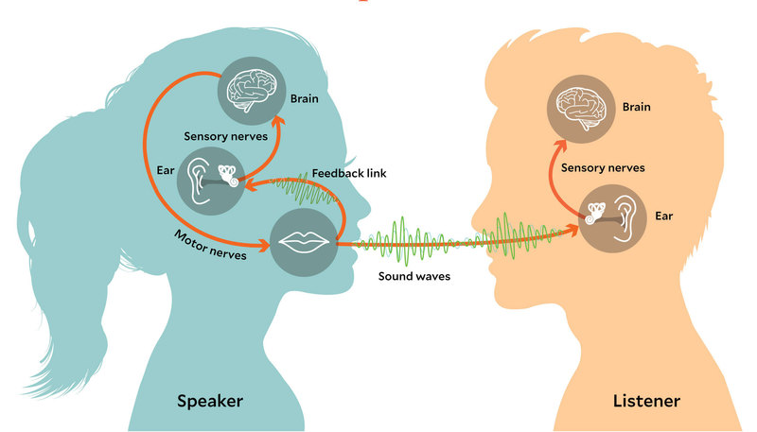
Mind and Language!
Speech chain

Slide 10
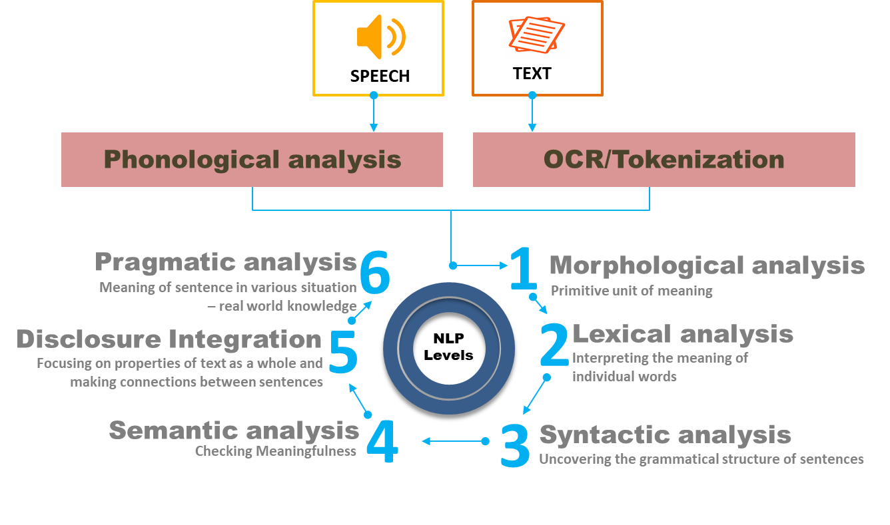
Different Levels of Analysis in NLP

Slide 11
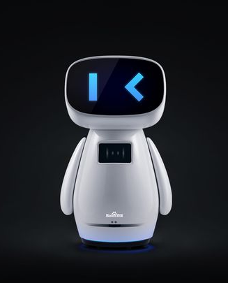
NLP Applications
Sentiment Analysis
Text Classification
Chatbots & Virtual Assistants
Text Extraction from Image
Machine Translation
Text Summarization
Auto-Correct
Speech Recognition (Speech to Text)
Text To Speech (TTS)

Slide 12
Introduction to Regular Expression (re)

Slide 13
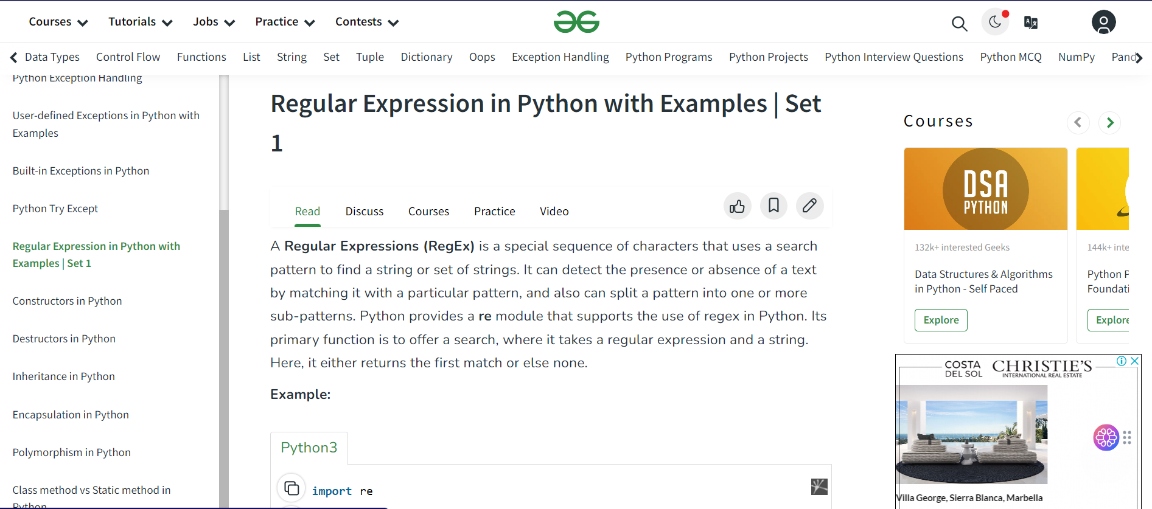
RE in Python, Let’s go!
Notes:
https://www.geeksforgeeks.org/regular-expression-python-examples-set-1/

Slide 14
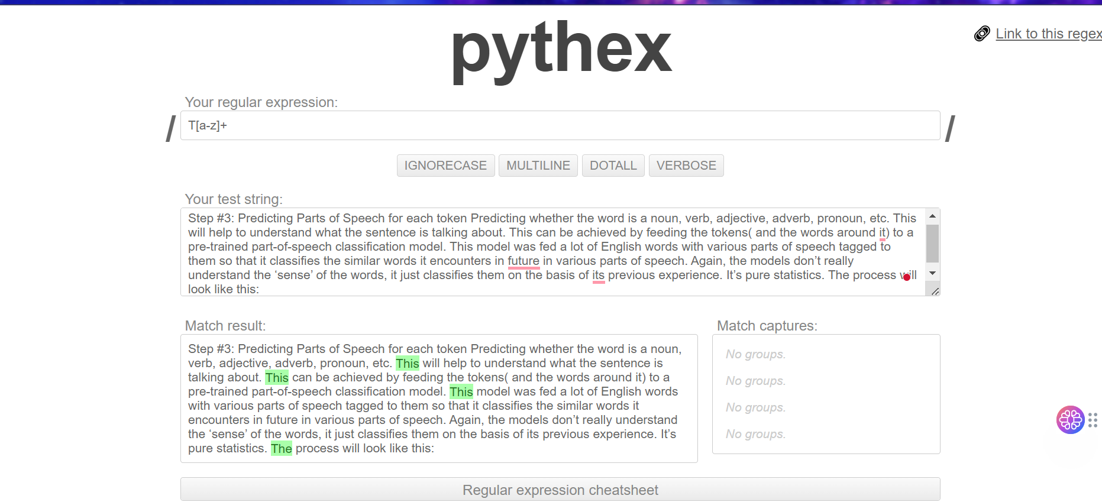
Pythex.org

Slide 15
Introduction to NLTK and Hazm

Slide 16
Some applicational packages in python

Slide 17
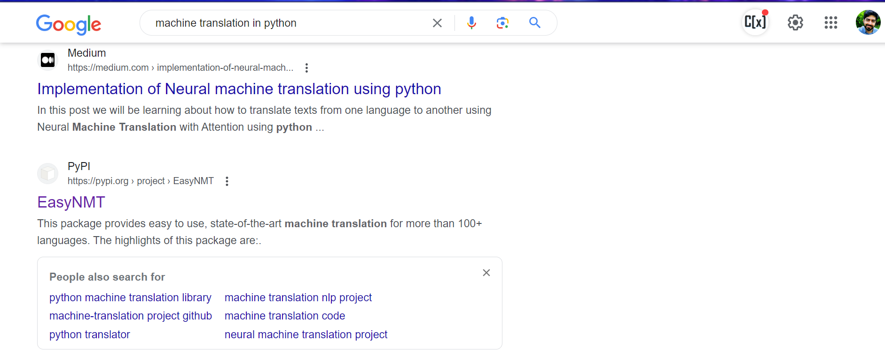
Search machine translation package in python!

Slide 18
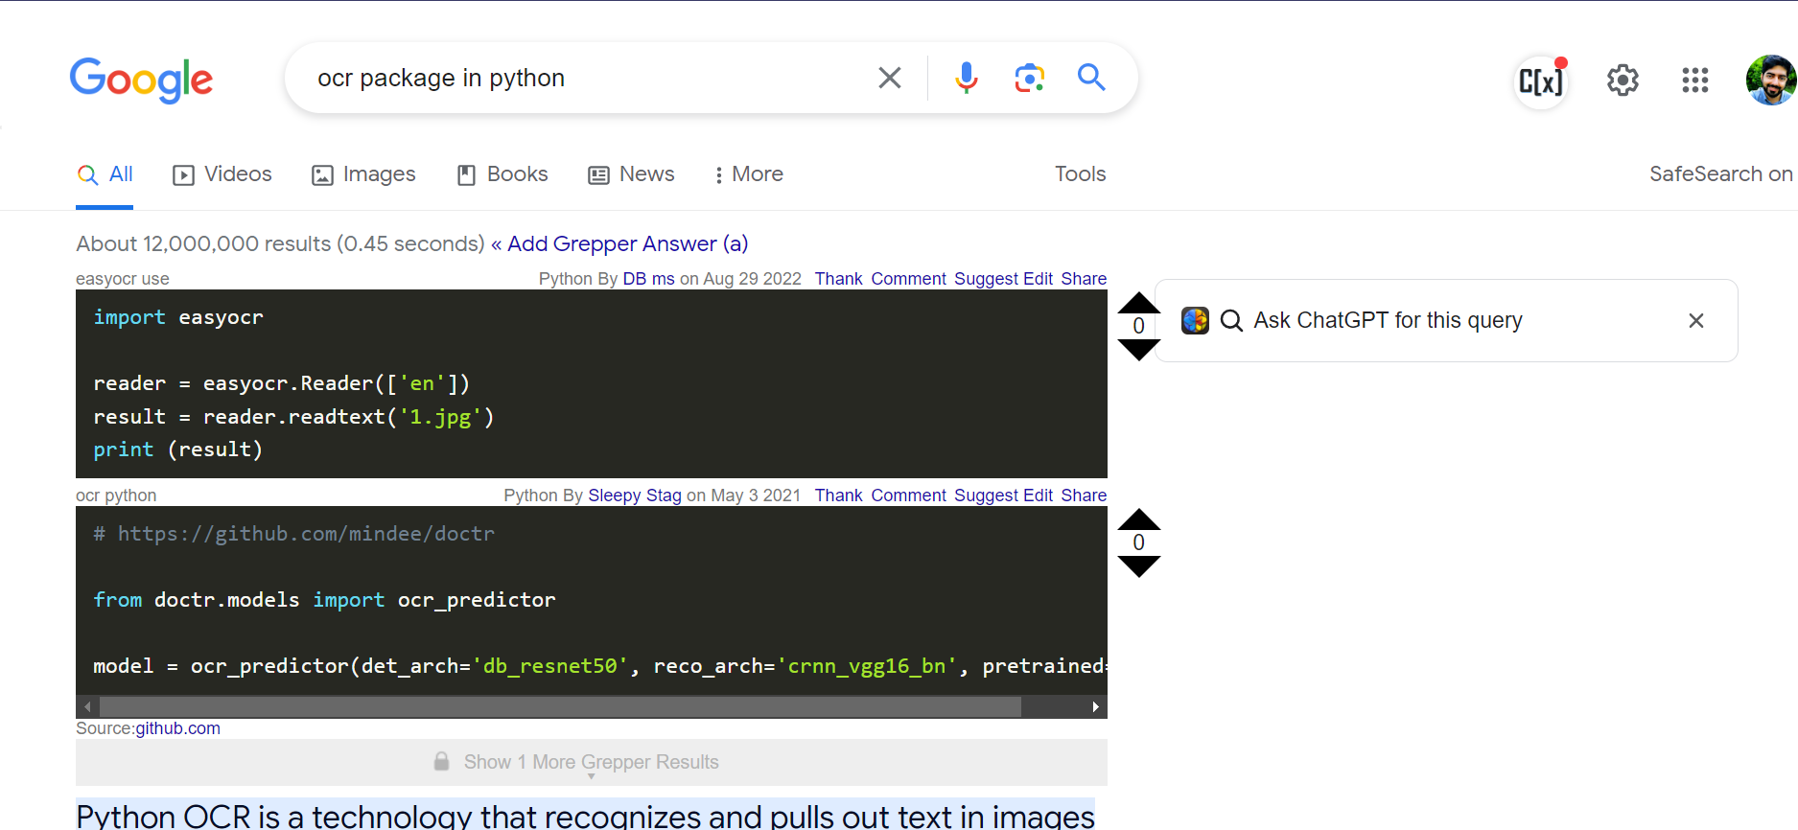
OCR, Read Images!

Slide 19

Is it enough?
You can search whatever you want, So learn how to search and use!

Slide 20
Application of Programming in the Digital Age!

Slide 21
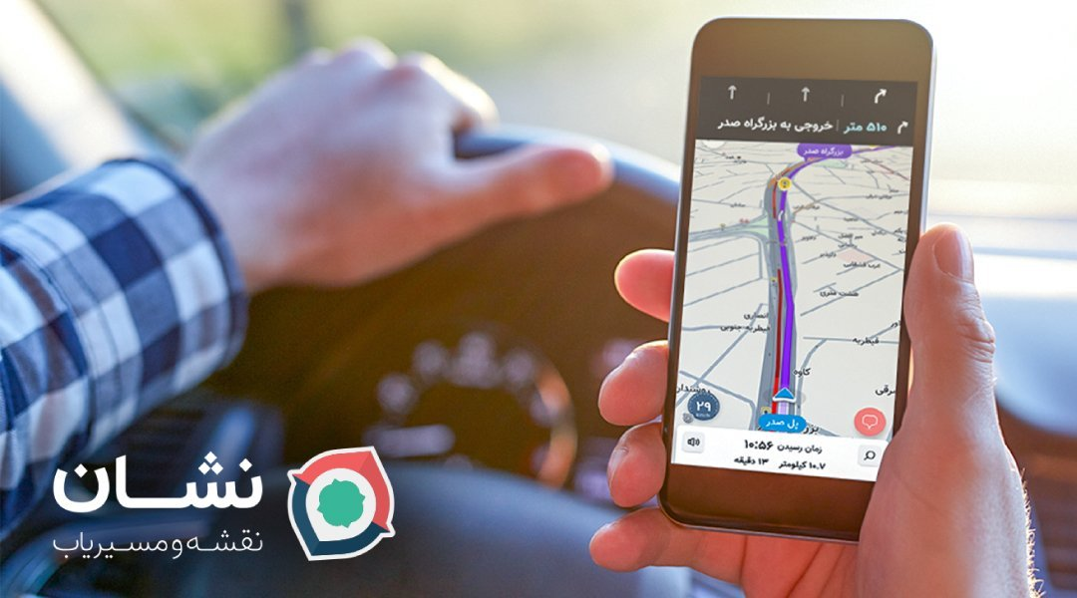
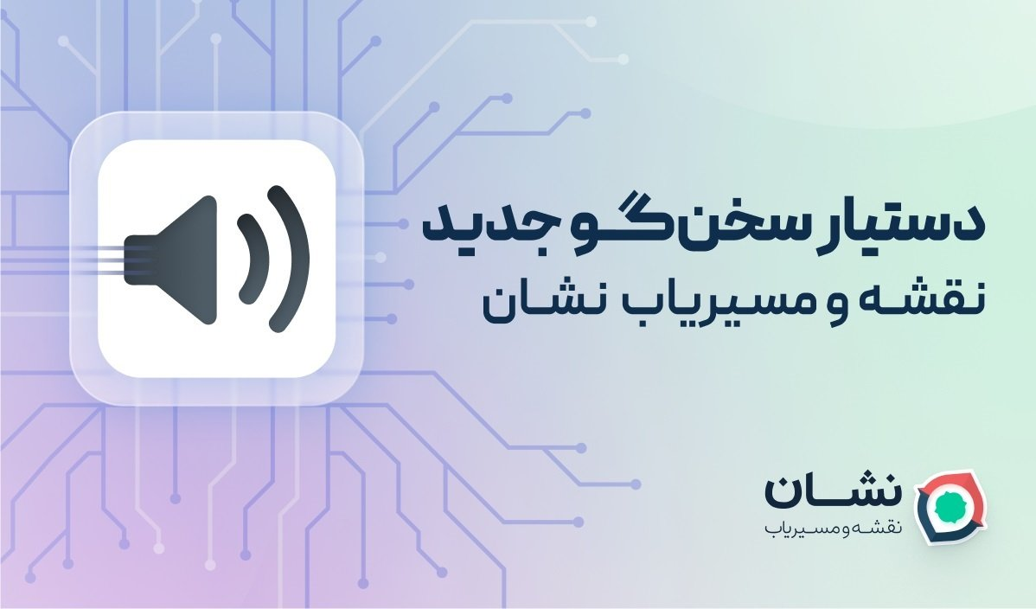
Notes:
https://unity.com/

Slide 22
Lecture Resources
https://www.geeksforgeeks.org/introduction-to-natural-language-processing/
https://www.geeksforgeeks.org/text-preprocessing-in-python-set-1/
https://www.tutorialspoint.com/python_text_processing/index.htm
https://www.w3schools.com/python/python_regex.asp
https://www.tutorialspoint.com/python/python_reg_expressions.htm
https://www.geeksforgeeks.org/regular-expression-python-examples-set-1/
https://pythex.org/

